Slide 1

一种基于商品评论的
多维度立体市场调研分析方法
A Comments-Based Multi-Dimensional Approach of
Commodity Market Research
——数据挖掘与数据仓库课程大作 516015910018 魏小渺

Slide 2
0. Overview
现存问题
原始数据集
横向挖掘：产品特性
纵向挖掘：市场-产品-评论
时序挖掘：上升期与衰退期
总结和展望

Slide 3


1. 主流方法和其问题
Star Ratings
NLP
统计学方发:
扁平的宏观群体指标
TFIDF+BOW：
聚类分类/协同推荐:
重要特征损失

Slide 4
2. 原始数据集
Amazon三种产品大类的共计6019种产品的具体产品的35024条评论
marketplace: 产品销售地，如US，CN
customer_id: 评论发出用户id
review_id: 该条评论的主键
product_id: 评论针对的具体商品id
product_title: 商品完整名称
product_category: 商品品类
star_rating: 评分星级1-5
helpful_votes: 评论有用数投票
review_headline: 评论标题
review_body: 评论内容
review_date: 评论发表日期
hair_dryer.tsv
microwave.tsv
pacifier.tsv
Industry | Comments | Products | Consumers | AVG Rating
Hair dryer | 14470 | 499 | 11348 | 4.12
Microwave oven | 1615 | 57 | 1612 | 3.44
Pacifier | 18939 | 5463 | 17761 | 4.30

Slide 5
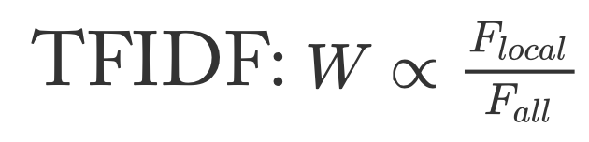

3. 横向挖掘：产品特性
<名词主语，系动词，形容词做标语>
<名词主语，系统词，形容词做宾语的定语>
TFIDF-Reverse 定义weight W（Noun and Adj）

Slide 6
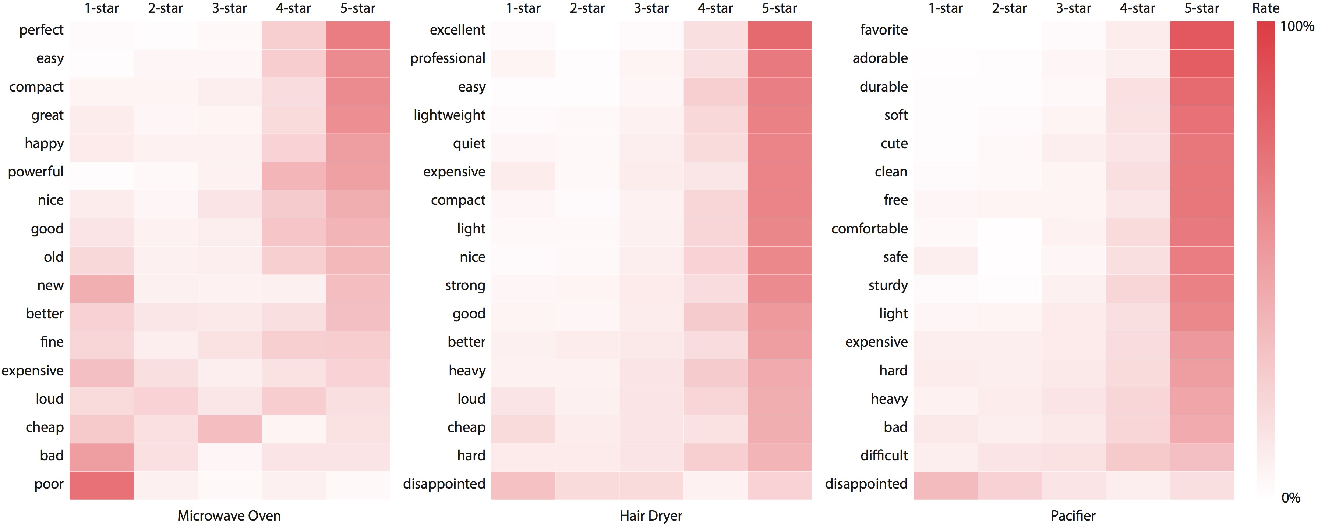
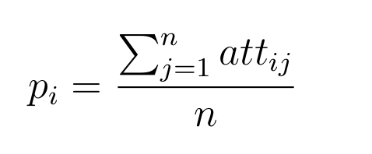
3. 横向挖掘：产品特性
Adjective rating distribution 定义attitude att

Slide 7
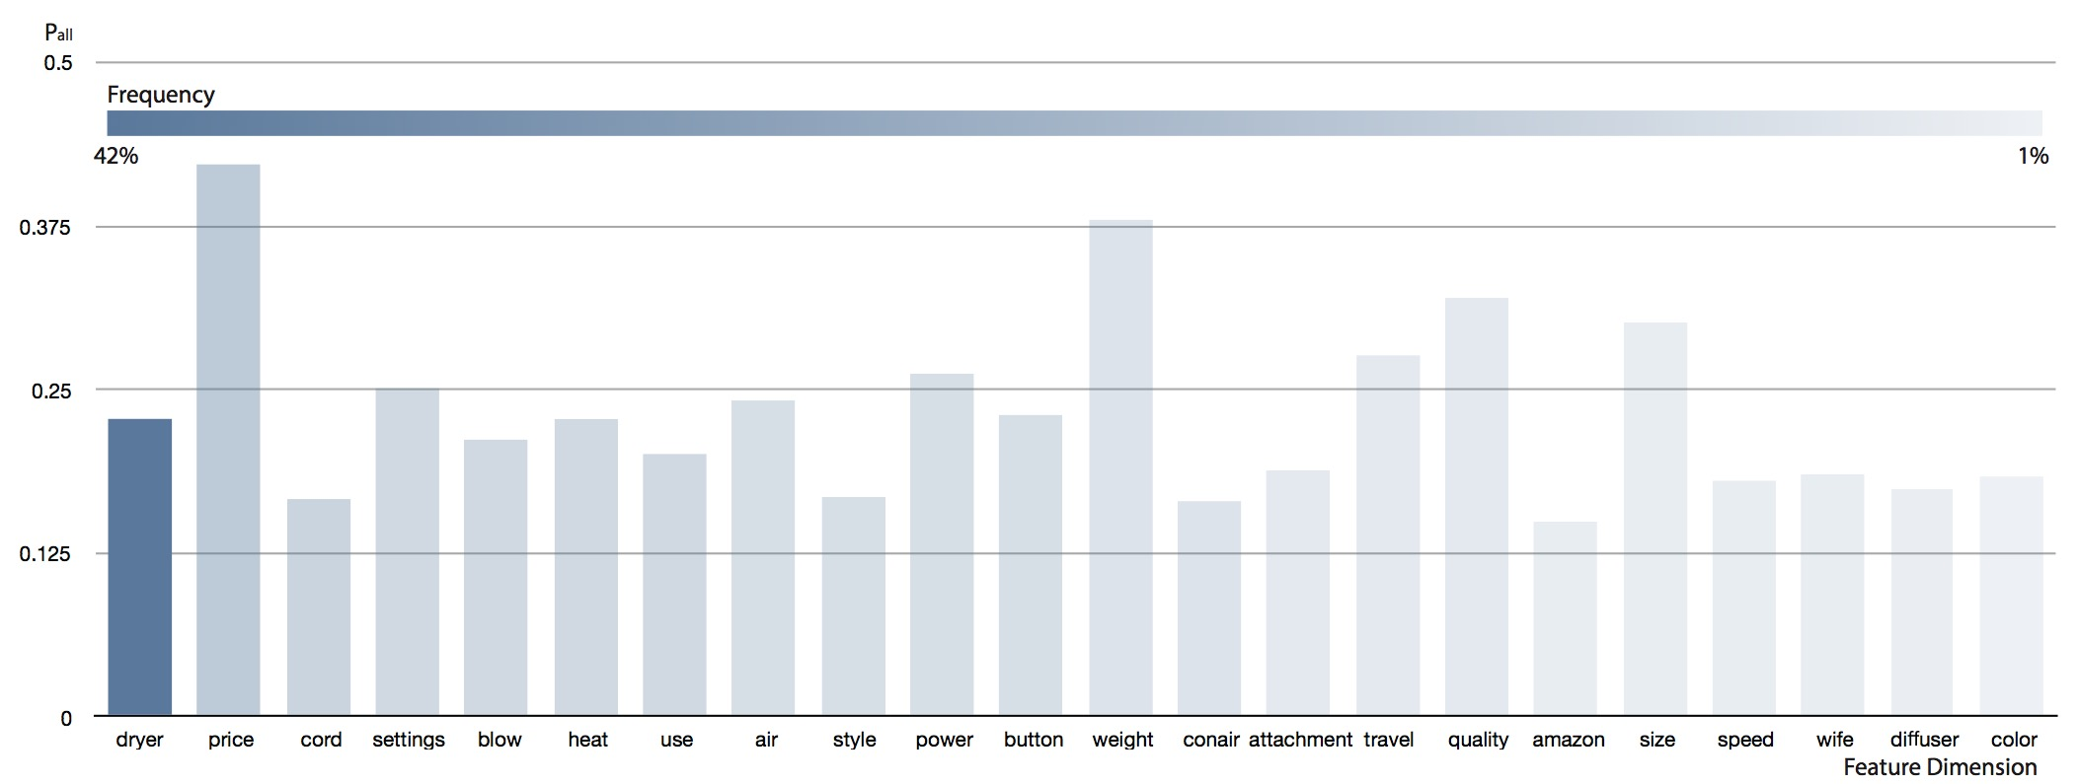
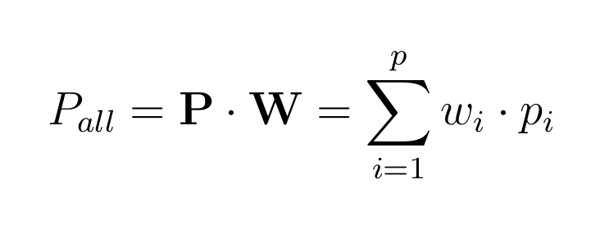
4. 纵向挖掘：市场

Slide 8
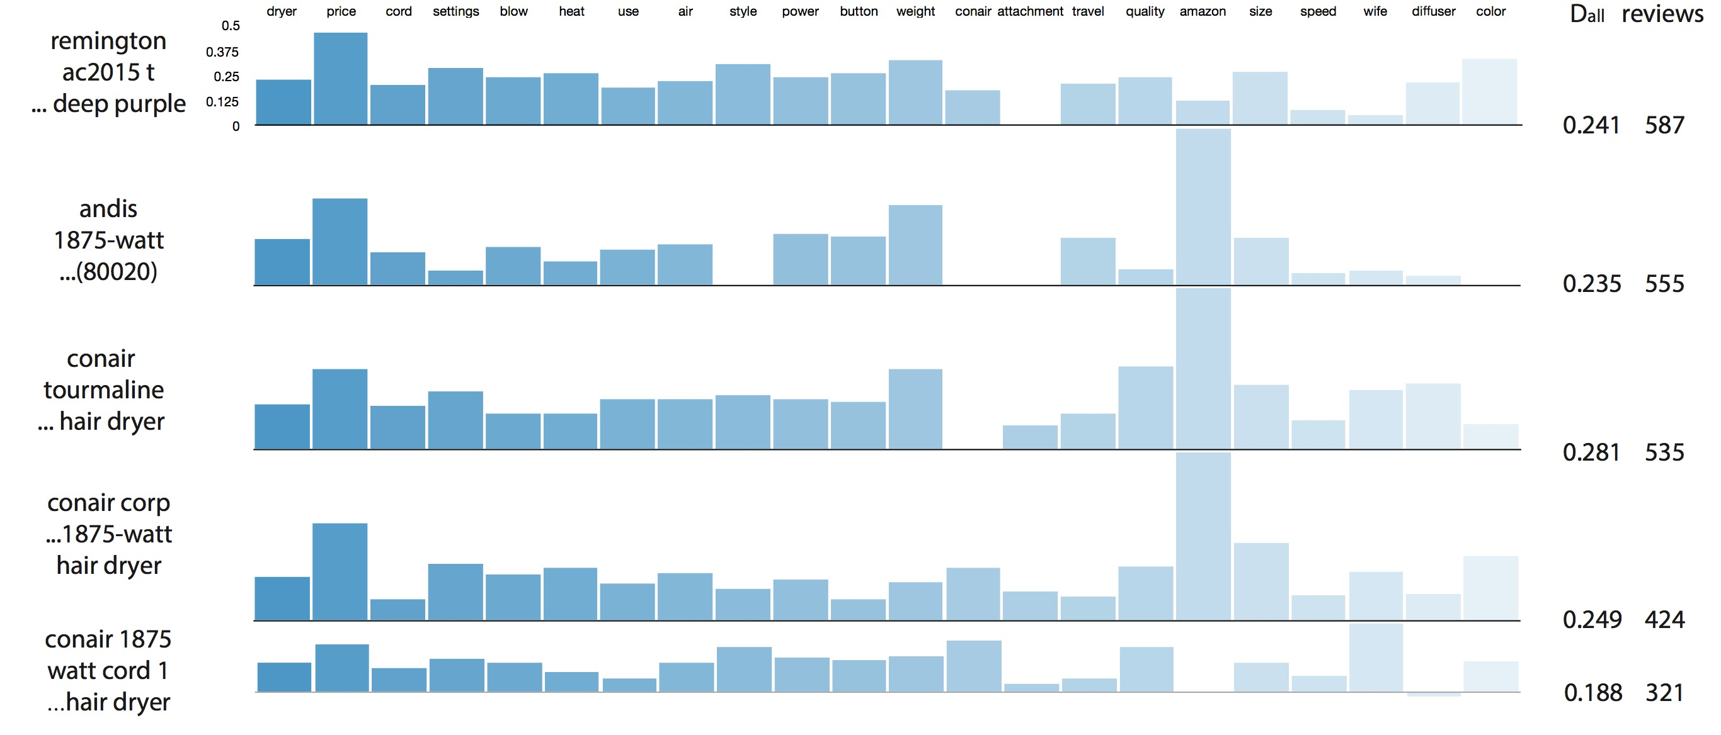
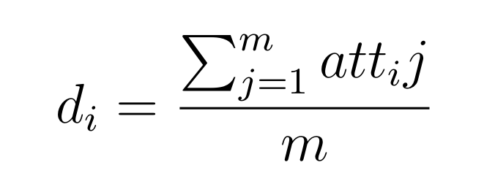
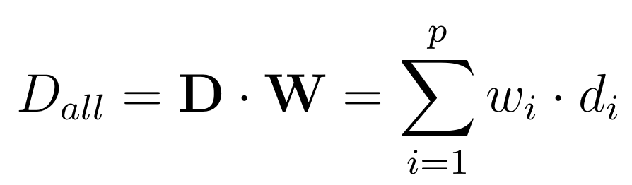
4. 纵向挖掘：产品

Slide 9
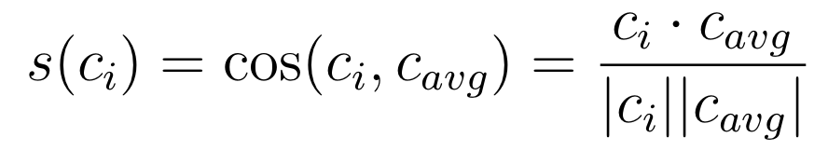
4. 纵向挖掘：评论

Slide 10
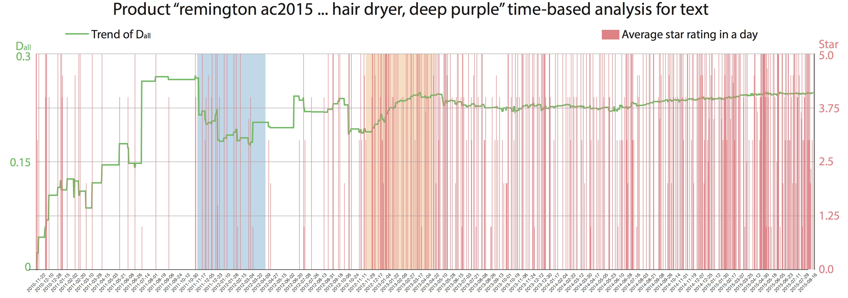
5. 时序挖掘：上升期与衰退期

Slide 11
5. 时序挖掘：上升期与衰退期

Slide 12
6. 展望和总结
TFIDF-Reverse 退化问题
NLTK复杂度，时间开销太大
上升期和衰退期识别问题

Slide 13
Reference + Q&A
G. Saridakis, Y. Lai, A.-M. Mohammed, and J. M. Hansen, “Industry characteristics, stages of e-commerce communications, and entrepreneurs and smes revenue growth,” Technological Forecasting and Social Change, vol. 128, pp. 56–66, 2018.
D. S. Sundaram, K. Mitra, and C. Webster, “Word-of-mouth communications: A moti- vational analysis,” ACR North American Advances, 1998.
Y. Chen and J. Xie, “Online consumer review: Word-of-mouth as a new element of mar- keting communication mix,” Management science, vol. 54, no. 3, pp. 477–491, 2008.
M. Geetha, P. Singha, and S. Sinha, “Relationship between customer sentiment and on- line customer ratings for hotels-an empirical analysis,” Tourism Management, vol. 61, pp. 43–54, 2017.
C. Danescu-Niculescu-Mizil, G. Kossinets, J. Kleinberg, and L. Lee, “How opinions are received by online communities: a case study on amazon. com helpfulness votes,” in Proceedings of the 18th international conference on World wide web, 2009, pp. 141–150.
T. H. Engler, P. Winter, and M. Schulz, “Understanding online product ratings: A cus- tomer satisfaction model,” Journal of Retailing and Consumer Services, vol. 27, pp. 113–120, 2015.
J. Otterbacher, “’helpfulness’ in online communities: a measure of message quality,” in Proceedings of the SIGCHI conference on human factors in computing systems, 2009, pp. 955–964.

